Slide 1
McIDAS-V, visualization and data analysis for Suomi National Polar-orbiting Partnership
William Straka III¹
Tommy Jasmin¹, Dan Lindsey², Steve Miller³, Thomas Rink¹, Don Hillger²
¹Cooperative Institute for Meteorological Satellite Studies, Space Science and Engineering Center, University of Wisconsin-Madison
²NOAA, RAMMB
³Cooperative Institute for Research in the Atmosphere, Colorado State University
1

Slide 2
Outline
Overview of McIDAS-V
Overview of Suomi NPP
Examples
Conclusions
2

Slide 3
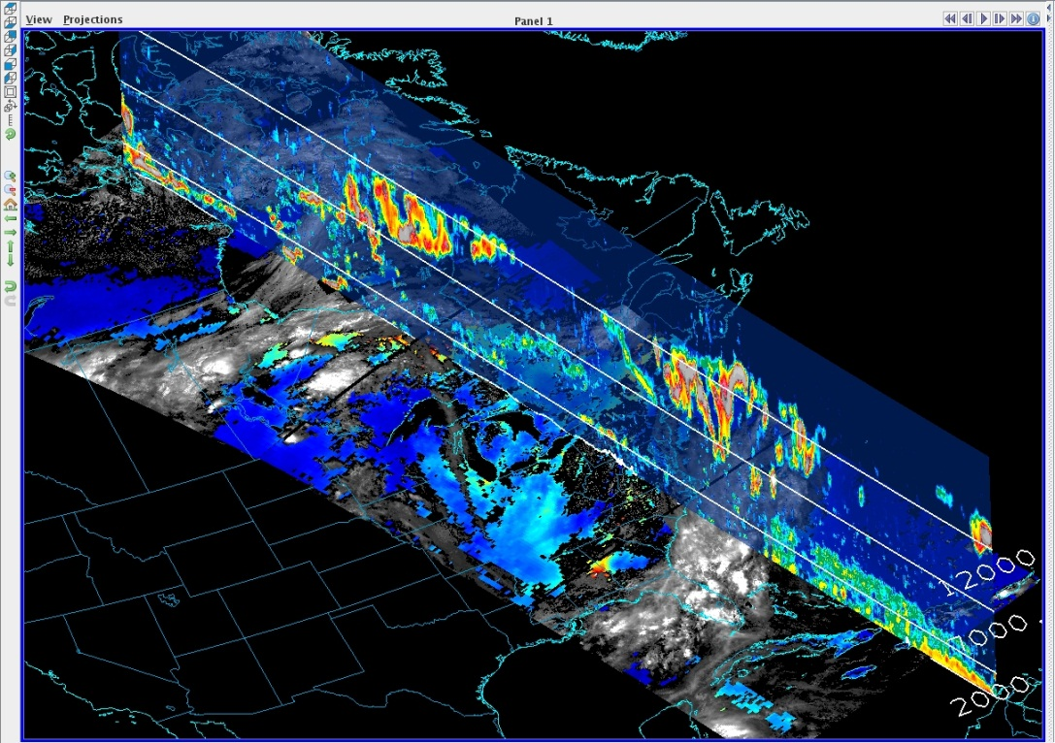
What is McIDAS-V
McIDAS-X → VisAD + IDV + HYDRA = McIDAS-V
Integration of Geophysical Data
Remote and Local Data Access
Powerful Analysis Tools
3D Visualization
Ease of Re-projection

Slide 4
Key Aspects of McIDAS-V
Built on top an extensible framework for adapting new sources of data (format and type, local or remote), user interface components and for creating novel displays and analysis techniques
Developed in the Java programming language – object oriented, write once run anywhere, very portable
Persistence mechanism (bundles) for saving and sharing interesting displays/analysis with other McIDAS-V users
Python based user defined computation
Open source, freely available, community driven software
Is able to easily read in and manipulate NPP with out any special readers
Notes:
HYDRA = Hyper-spectral data research application

Slide 5
Suomi NPP
S-NPP observes the Earth’s surface twice every 24-hour day, once in daylight and once at night.
It has 5 instruments which retrieve data regarding the atmosphere, land and ocean
  VIIRS
  CERES
  CrIS
  ATMS
  OMPS
5

Slide 6
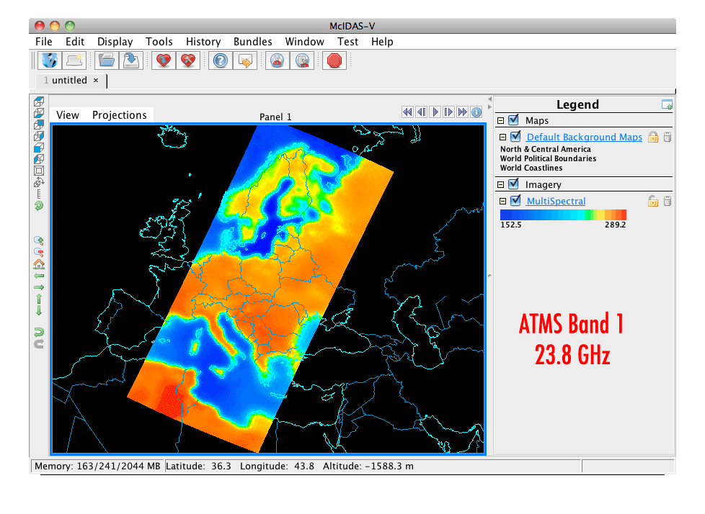
Advanced Technology Microwave Sounder
(ATMS)
22 microwave channels, combining all the channels of the preceding AMSU-A1, AMSU-A2, and AMSU-B sensors into a single package
Provides sounding observations needed to retrieve profiles of atmospheric temperature and moisture for forecasting models and continuity for climate monitoring purposes.
6

Slide 7
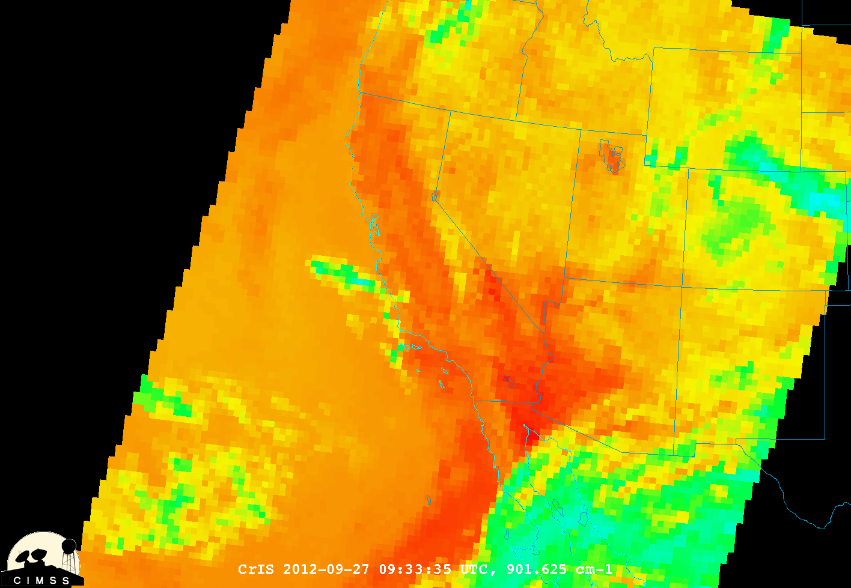
Cross-track Infrared Sounder
(CrIS)
1,305 infrared spectral channels
Designed to provide high vertical resolution information on the atmosphere's structure of temperature and water vapor.
7

Slide 8
Visible Infrared Imaging Radiometer Suite (VIIRS)
Has 22 channels at three different resolutions
  16 Moderate Band (M-Band) channels (~750 m at nadir)
  5 high resolution (I-Band) channels (~375 m at nadir)
  Day Night Band (~750 m at nadir)
M and I band data encompass data from 412 nm to 12 μm
Used to produce Level 2 products
8

Slide 9
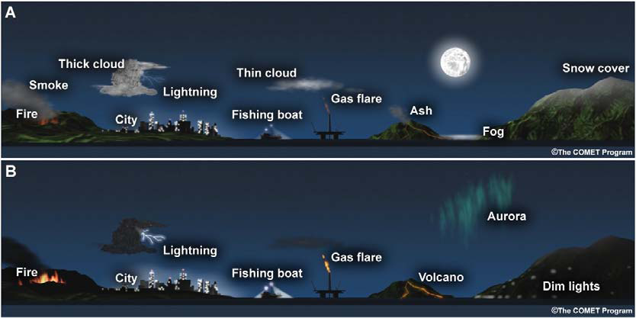
Day Night Band
The DNB measures visible radiances from both the Earth and atmosphere
Wavelength of 0.7 μm, 742m x 742m pixel size
Receives visible data from via reflection and emission sources (natural and anthropogenic )
Stray light fix implemented August 21, 2013
Figure 1 from Lee et al (2005)
9
2013 EUMETSAT Meteorological Satellite Conference
16-20 September 2013, Vienna, Austria

Slide 10
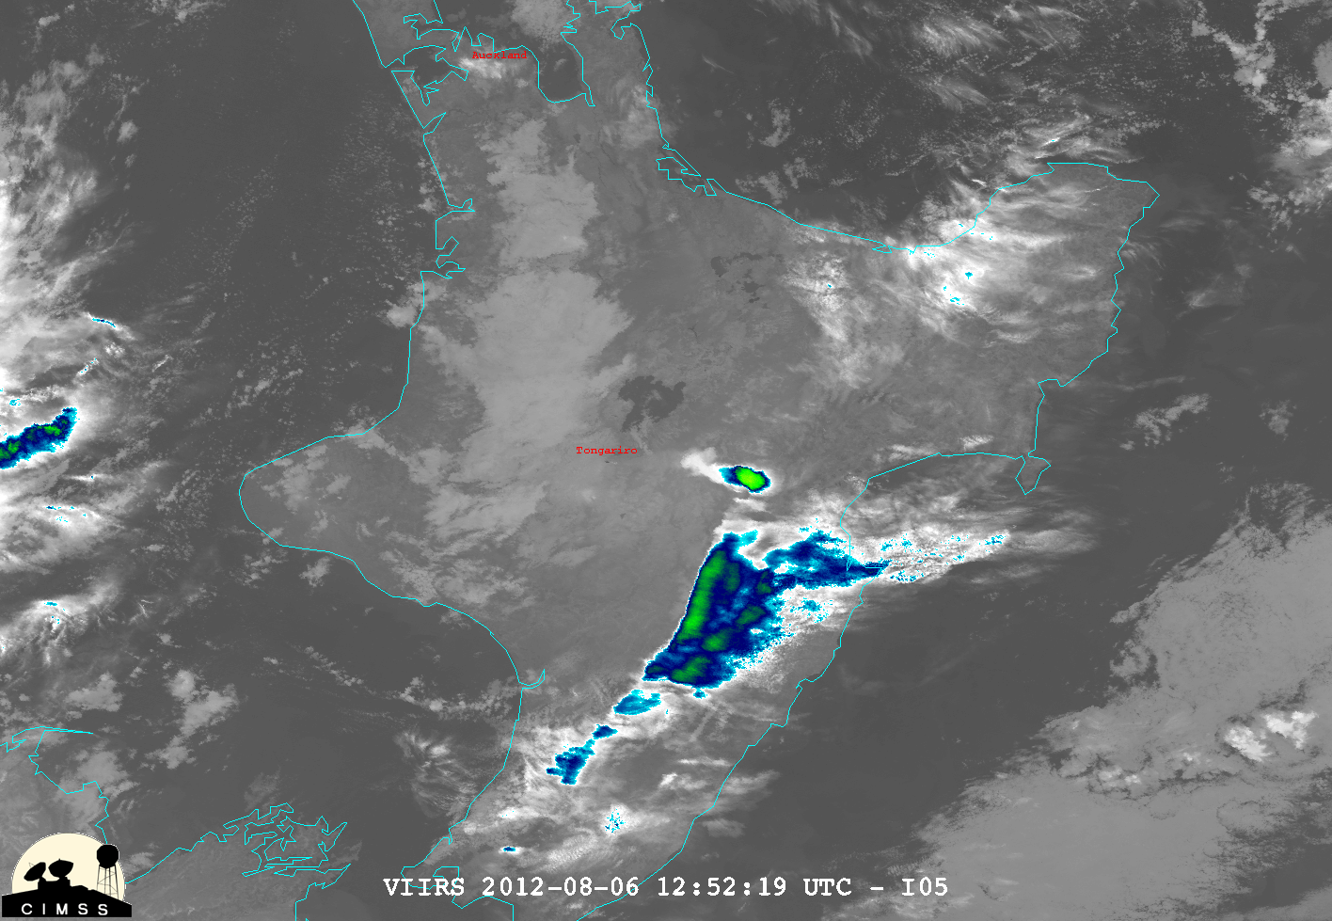
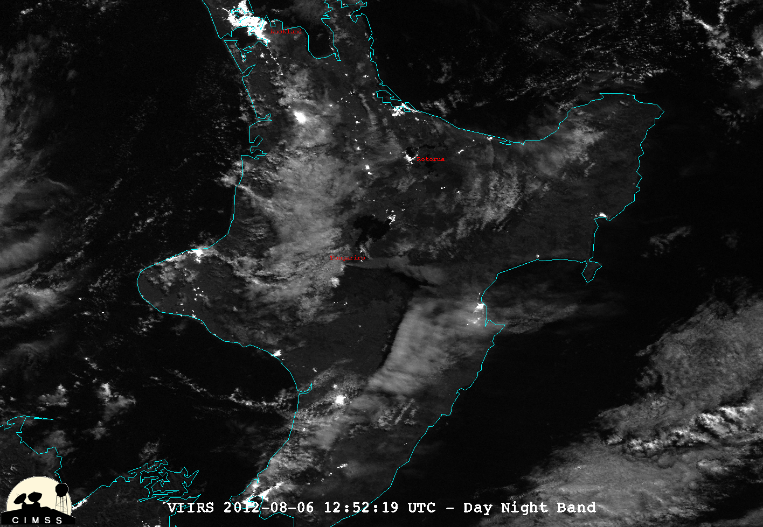
Tongariro (New Zealand)
August 6, 2012 – 1252Z
Ash
10
NASA Image of the Day
http://earthobservatory.nasa.gov/NaturalHazards/view.php?id=78791

Slide 11
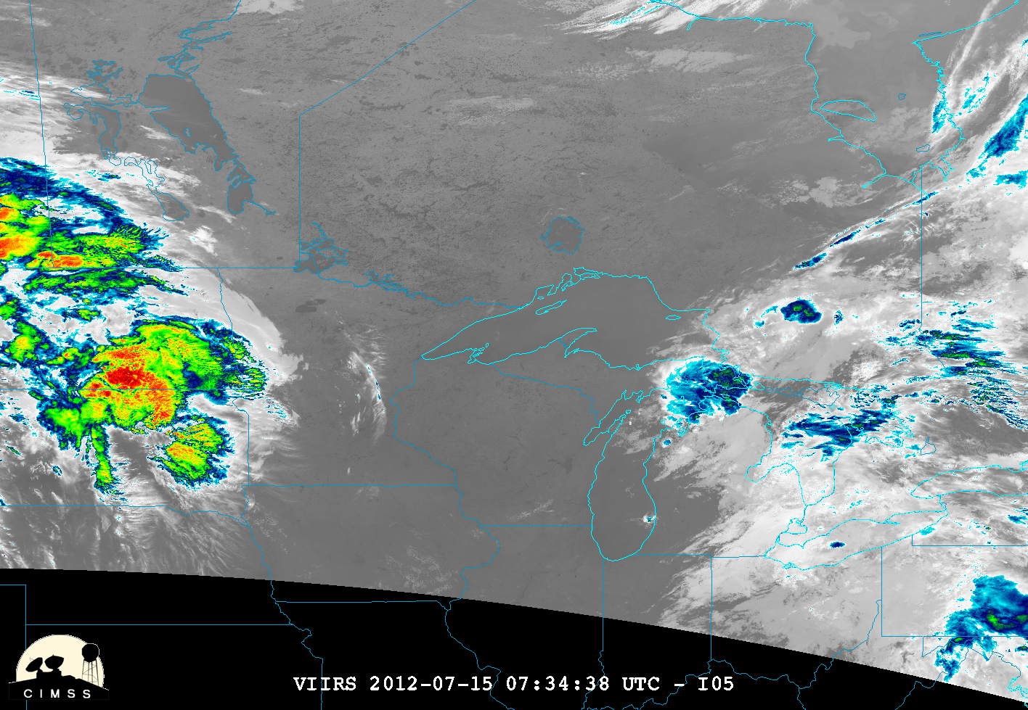
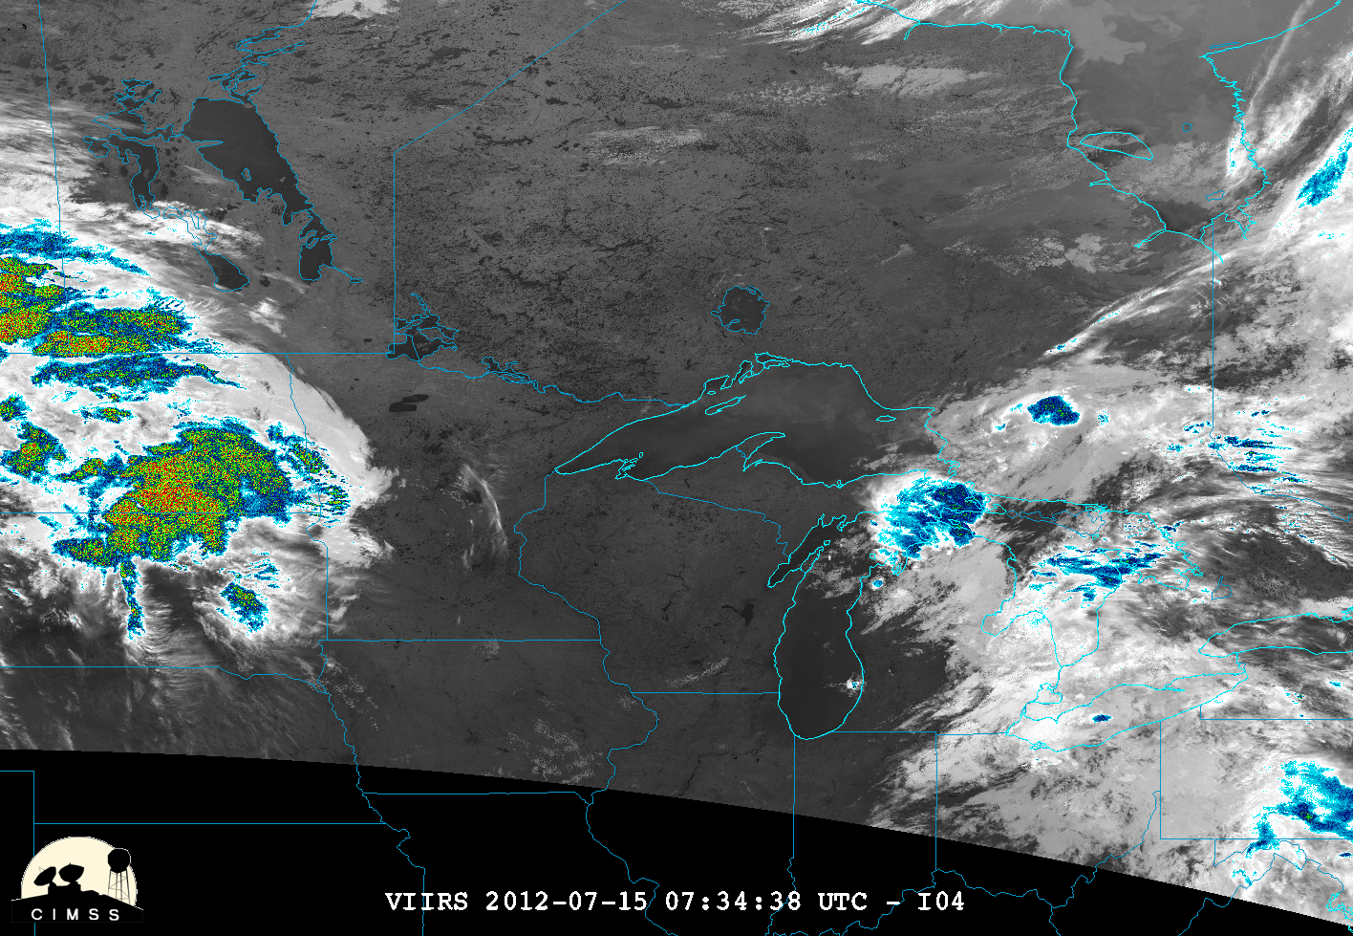
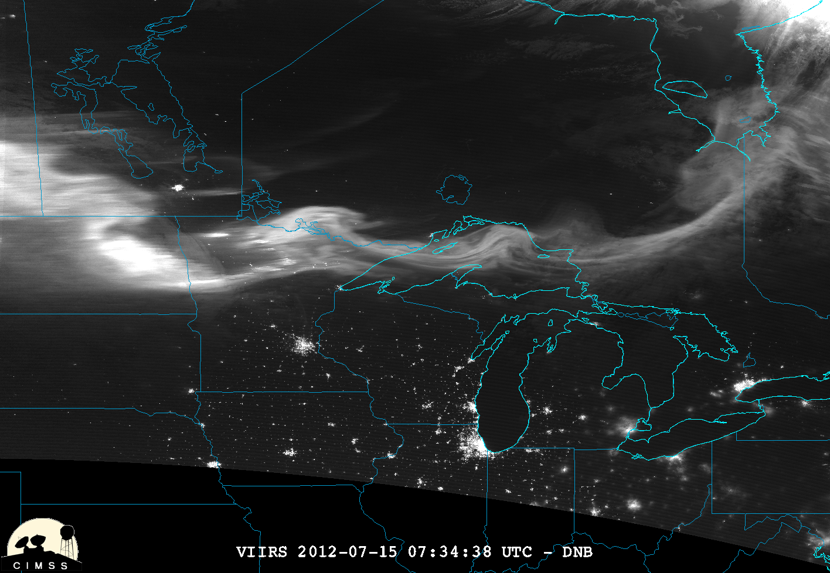
VIIRS (11, 3.9μm and DNB)
0733Z, July 15, 2012
Fires
Winnipeg
Aurora
Chicago
11

Slide 12
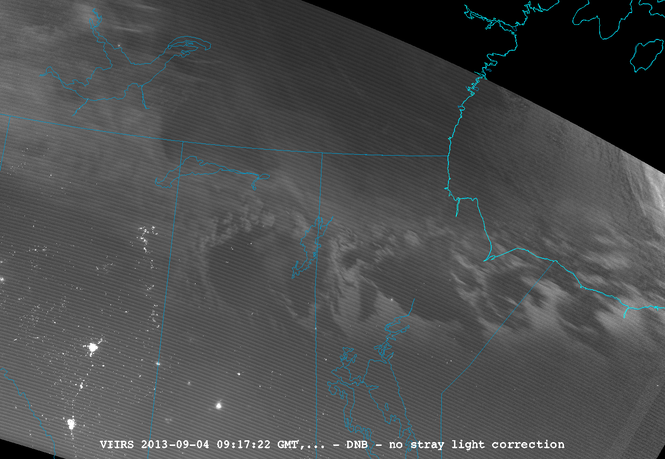
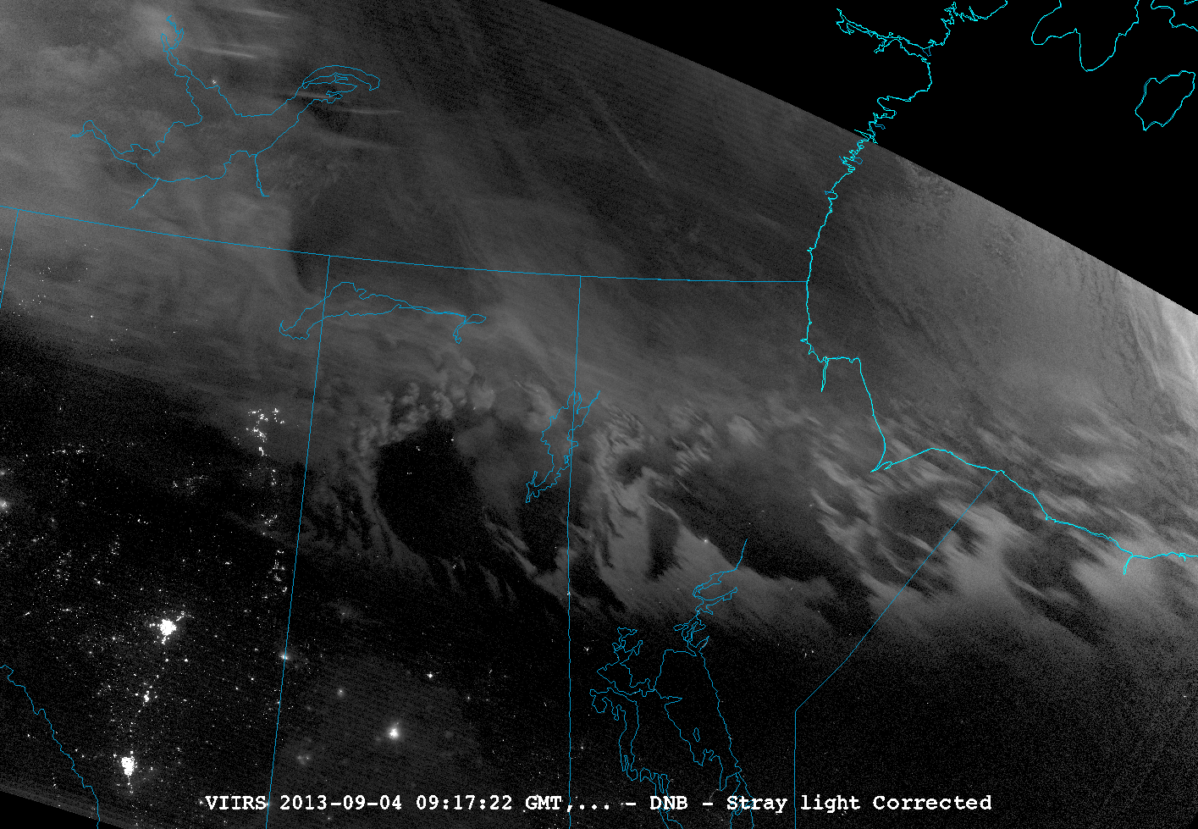
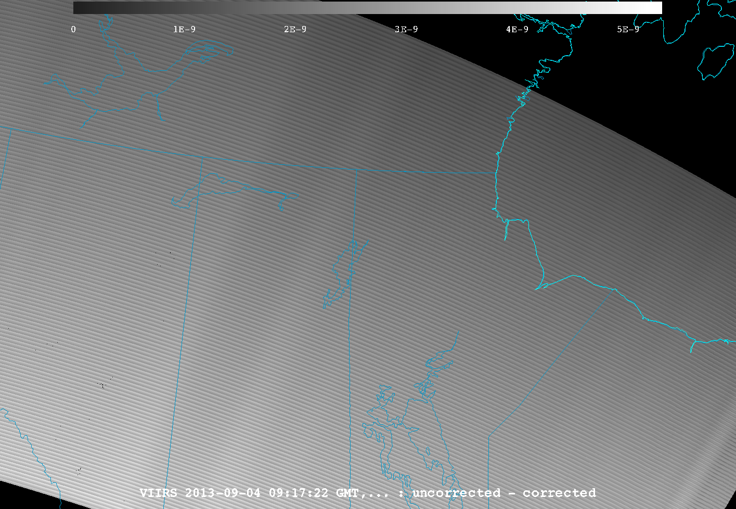
VIIRS Channel Differencing
DNB Stray light example
12

Slide 13
VIIRS SDR
Ancillary data
13

Slide 14
Visible Infrared Imaging Radiometer Suite (VIIRS) EDR
There are a series of 20 Environmental Data Records (EDRs) produced from VIIRS
McIDAS-V has been able to sucessfully ingest all but the Imagery EDRs
  Imagery EDRs are expected to work by end of 2013
McIDAS-V can unpack and display bit level data.
  Ex. Displaying cloud mask test results
14

Slide 15
VIIRS DNB, Surface temperature
2236Z, 09/29/2012
Kampala
Lake Albert
Fog
Kigali
Mwanza
Lake Victoria
15

Slide 16
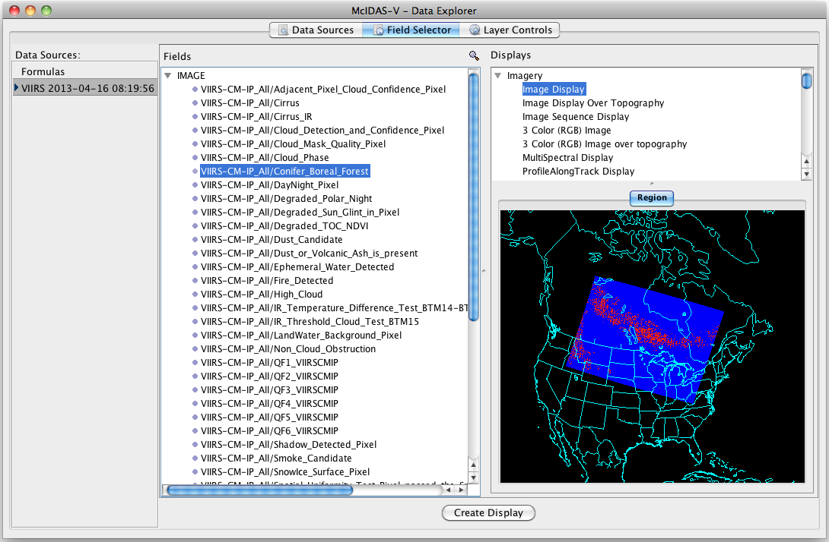
Product EDR Variable selection

Slide 17
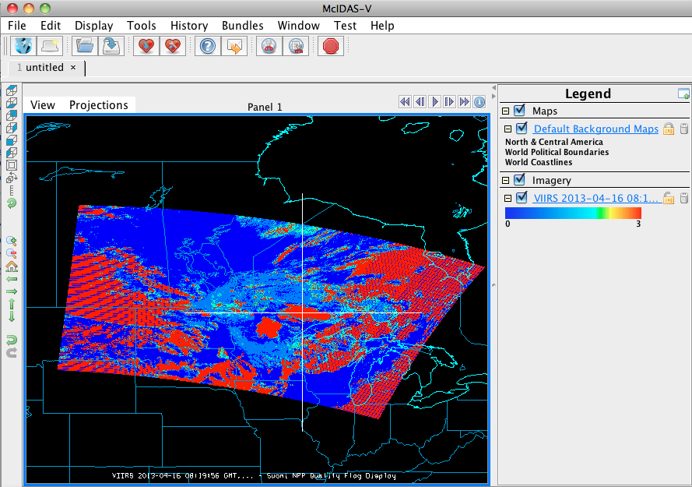
Product EDR Data Probe

Slide 18
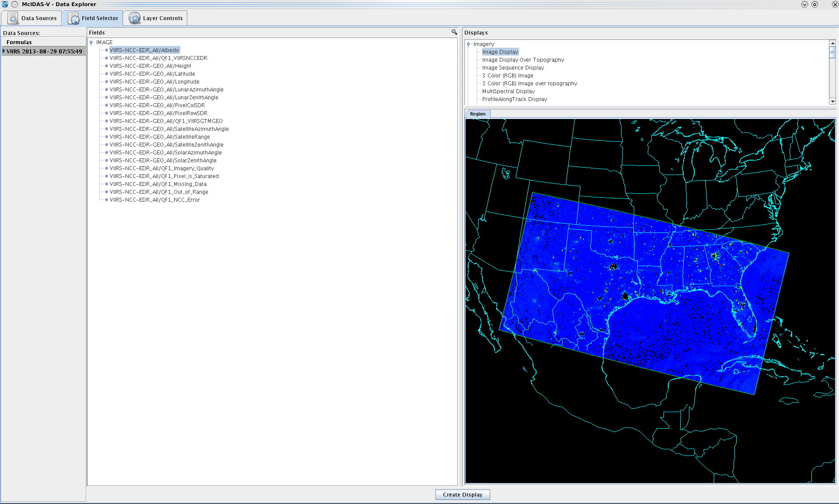
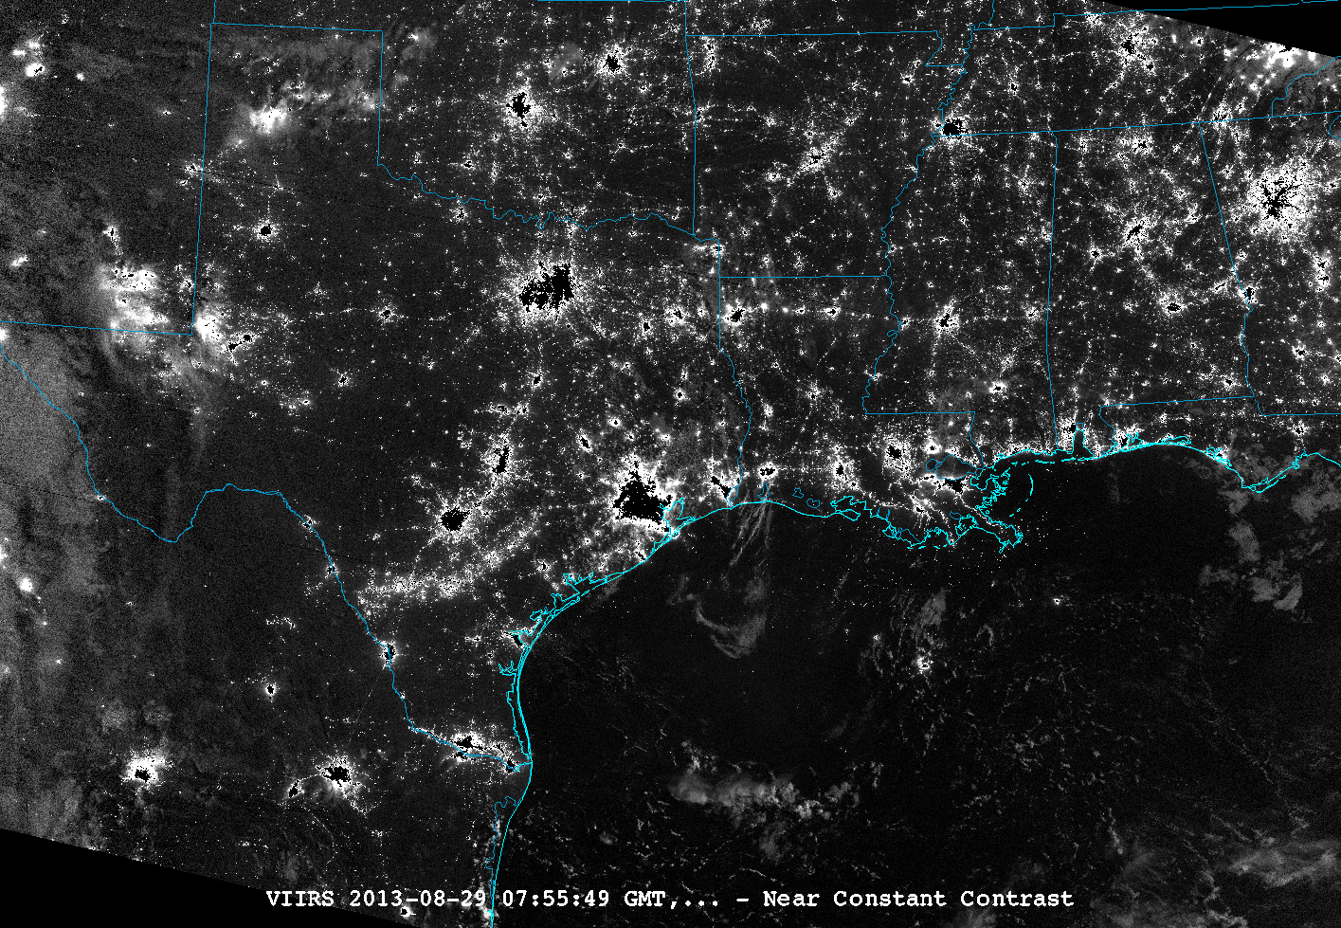
Imagery EDRs

Slide 19
Conclusions
McIDAS-V is a free, open source tool which can be used to evaluate data from various instruments on Suomi NPP, assuming the data is in the IDPS/CLASS NPP format
  Allows for intercomparison with other sensors and satellites as well as exploration of geolocation and bit flags
It can be used to easily make images and animations for presentations
Improvements continue including adding VIIRS intermediate products
19

Slide 20
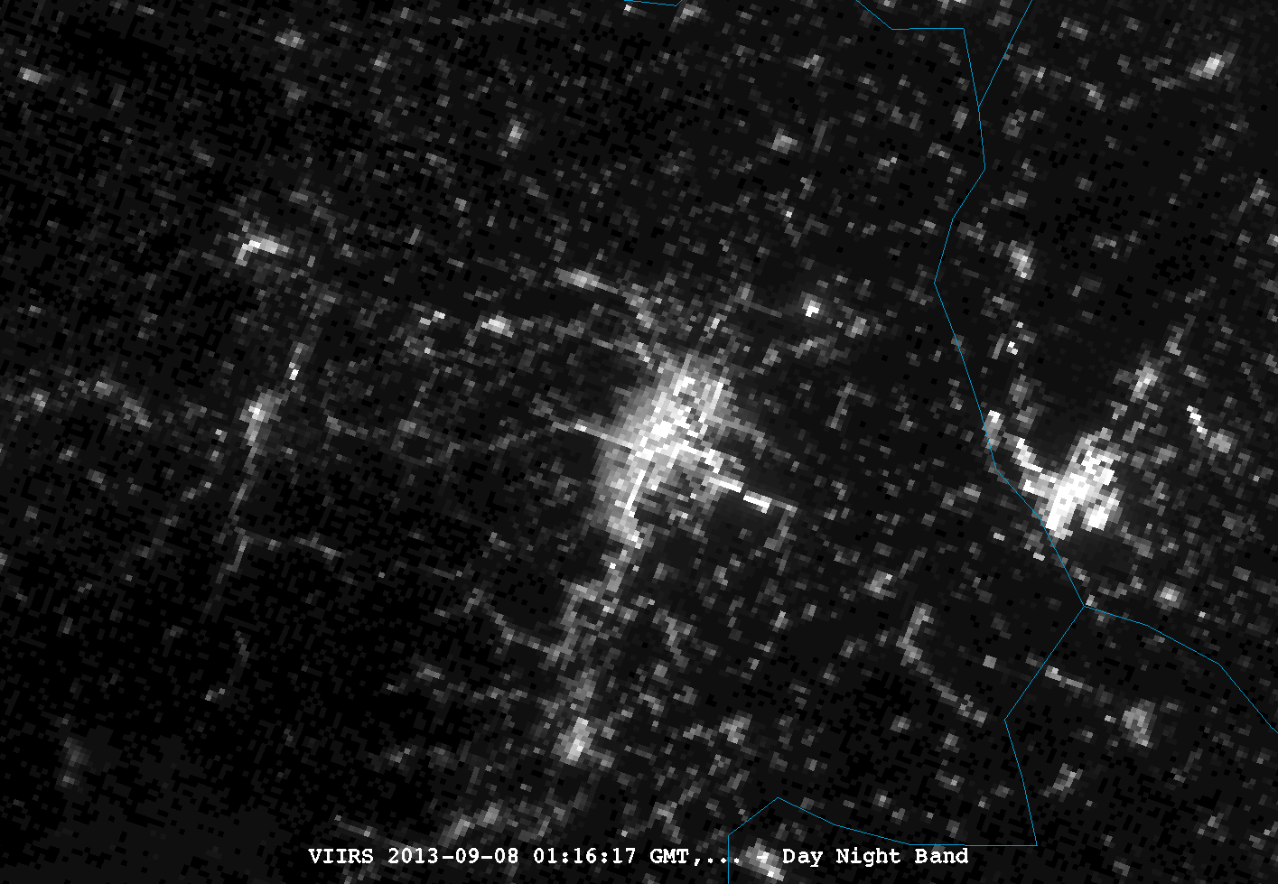
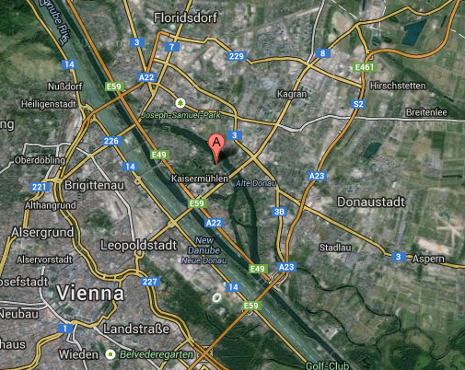
QUESTIONS?
Austin
San Antonio
20

Slide 21
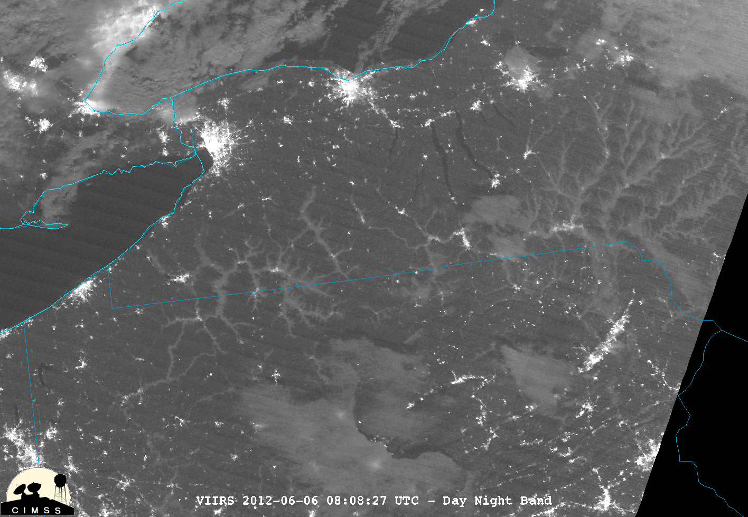
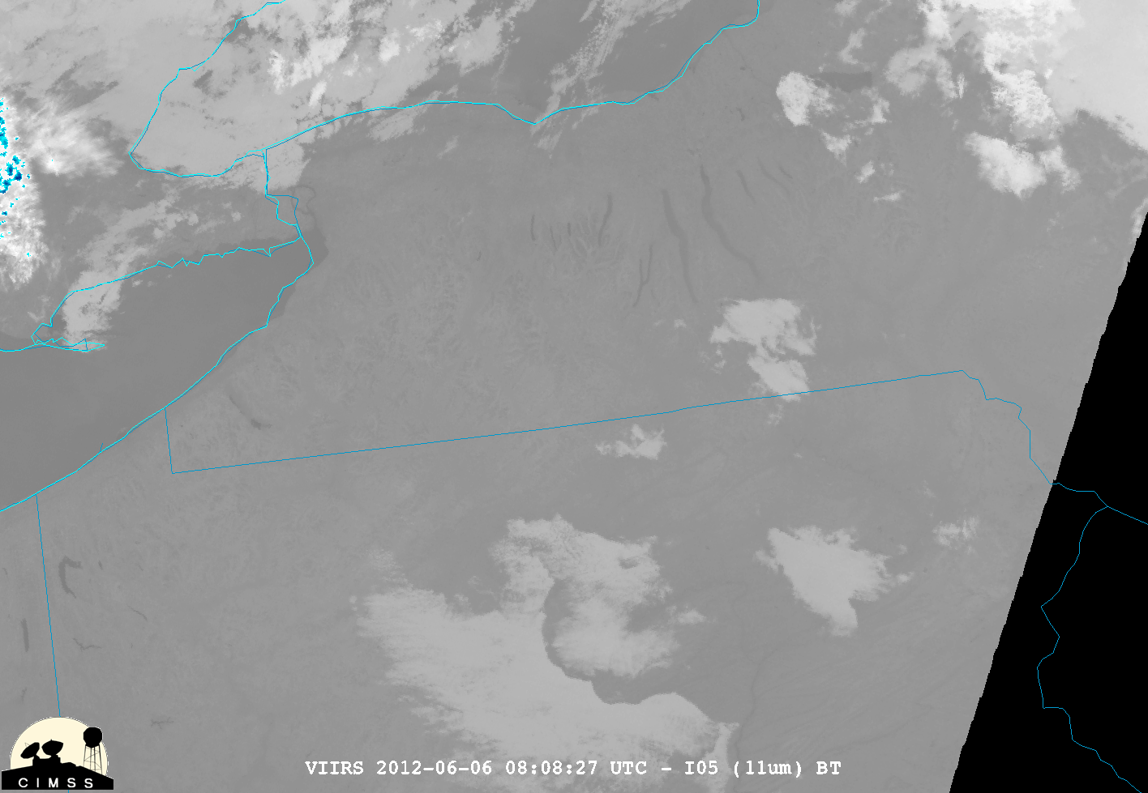
Allegheny River fog event
Toronto
Rochester
Syracuse
Buffalo
Finger Lakes
Fog
Clouds
21

Slide 22
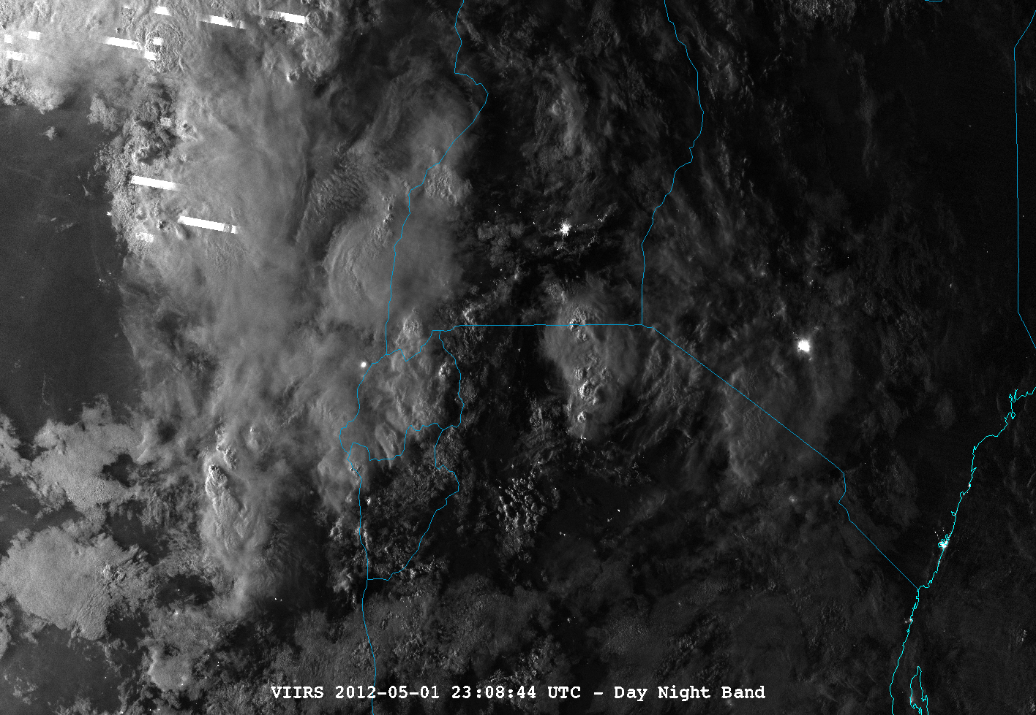
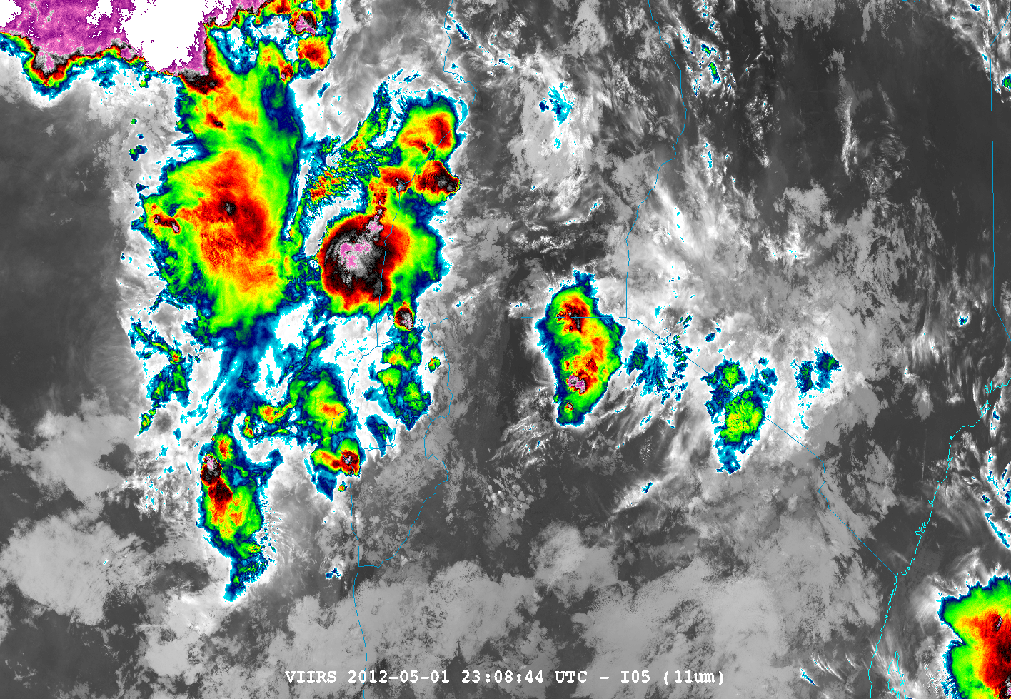
VIIRS DNB / 11um
2308Z, 5/1/2012
Lightning “streaks”
Kampala
Nairobi
Mombasa
Lake Victoria
22

